Slide 1
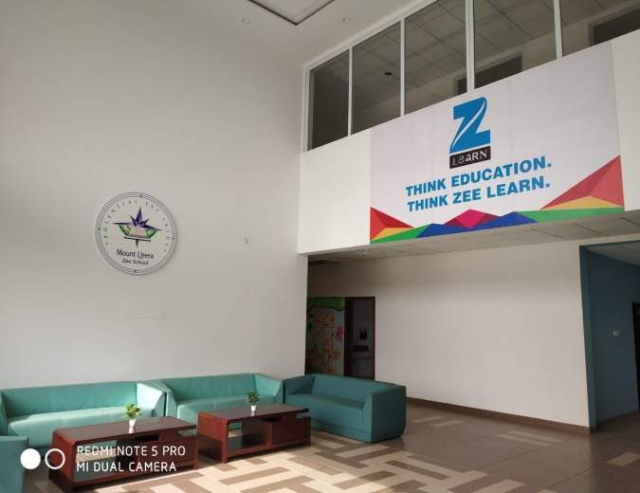
Mount Litera Zee School,Gondia

Slide 2
Welcome to Parent Induction
Pre Primary
This brief presentation will familiarize
you with the plans we have made
for the Academic Session 2019-2020

Slide 3
Overview
Zee Learn is India’s leading company in education segment with the fastest growing chain of K-12 schools – Mount Litera Zee School and Asia’s No 1 chain of pre-school network – Kidzee in its portfolio.
With one of the most advanced teaching methodology – Litera Octave,
Zee Learn under its brand name Mount Litera Zee Schools provides promising education to the future generation enabling
them to explore their true unique potential.
Awarded as the ‘K-12 School Chain of the Year’
at Indian Educational Congress in 2015,
Mount Litera Zee school has over 130 schools
in 80+ cities nationwide.

Slide 4
Mission Statement
“ To create an excellent education institution
synthesising the human values with the
highest quality of teaching – learning using
modern technology-driven tools for preparing
a well-rounded personality for our society.”

Slide 5
LET US INTRODUCE
YOU
TO THE
MANAGEMENT COMMITTEE

Slide 6
Management (Director and Chairman)
Regional School Director
Principal
Primary & Middle Academic
Co-ordinator
Pre-Primary Academic Co-ordinator
Educators
Accounts
Relationship Manager
Receptionist
Transport In-charge
House Keeping

Slide 7
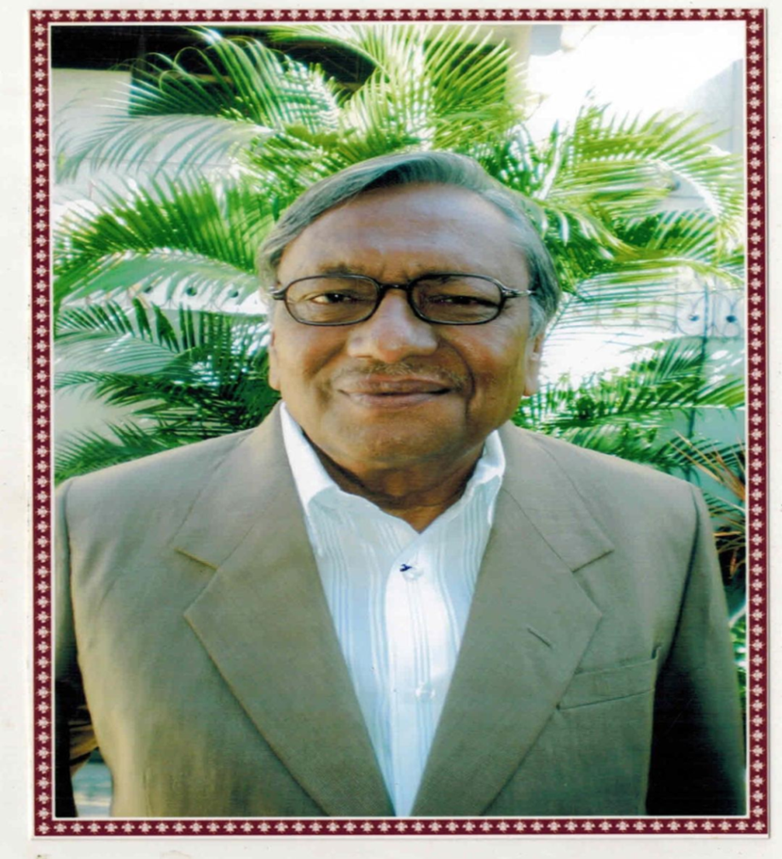
OUR FOUNDERS
Our Chairman
Mr.Gajanan Agrawal

Slide 8
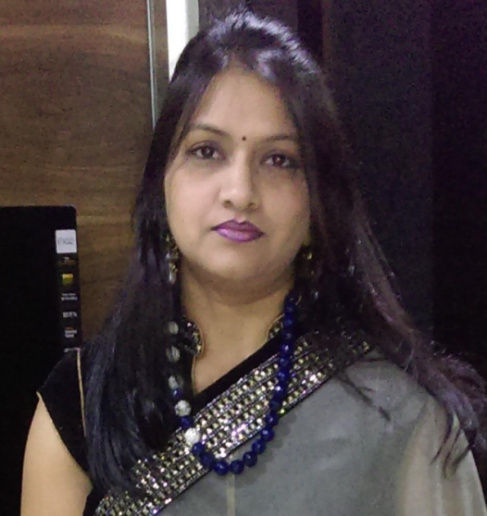
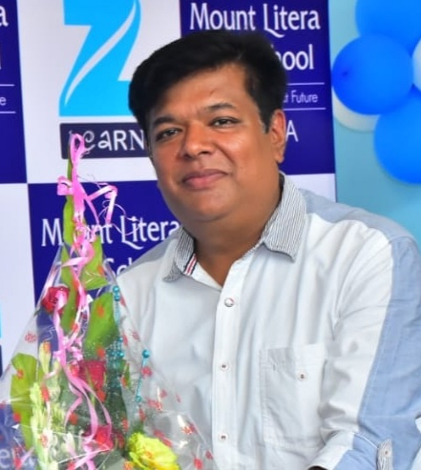
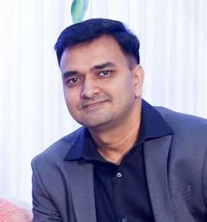
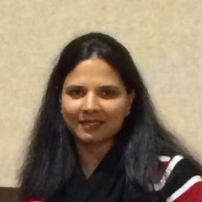
OUR BOARD OF DIRECTORS
Ms. Nishi Agrawal
Mr.Nitish Agrawal
Mr.Lalit Kumar
Ms.Roopa Jalan

Slide 9
Our Mentor
Regional School Director
West Zone Zee Learn
Name :- Ms. Satwant Palekar
Ph. No. :- 9819987979
E-mail :- satwant.palekar@zeelearn.com

Slide 10
Principal
Contact No. :-
E-mail :- principal.gondia@mountlitera.com

Slide 11
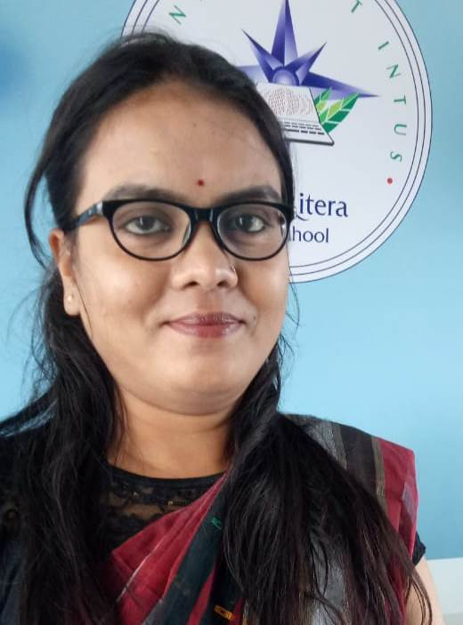
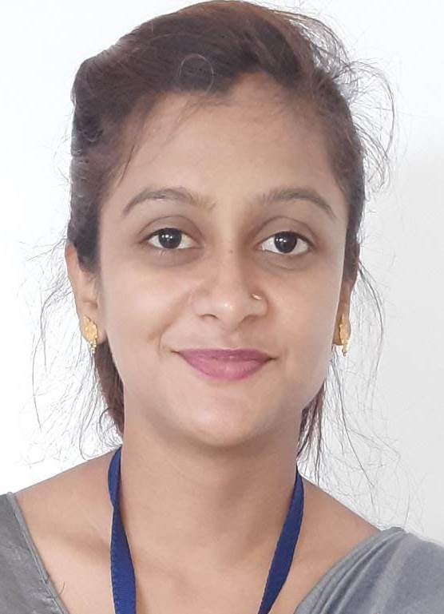
For Your Reference
Academic Coordinator
Ms. Prachi Nagdeve
Pre-Primary Coordinator
Ms. Firdosh Ansari

Slide 12
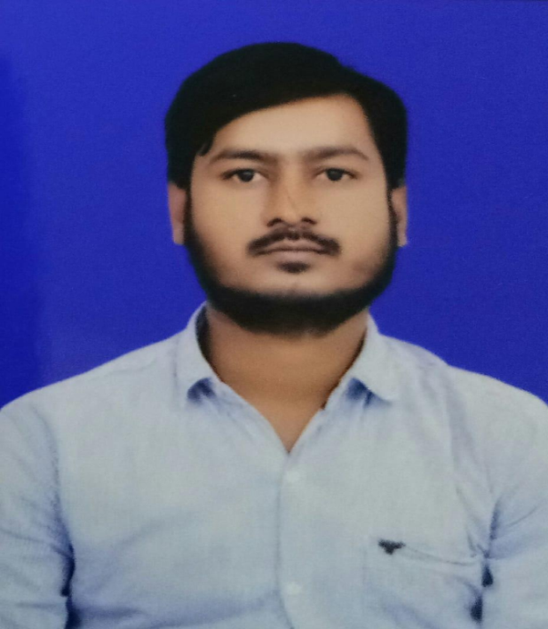
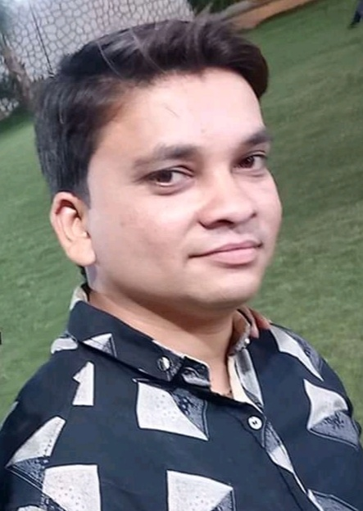
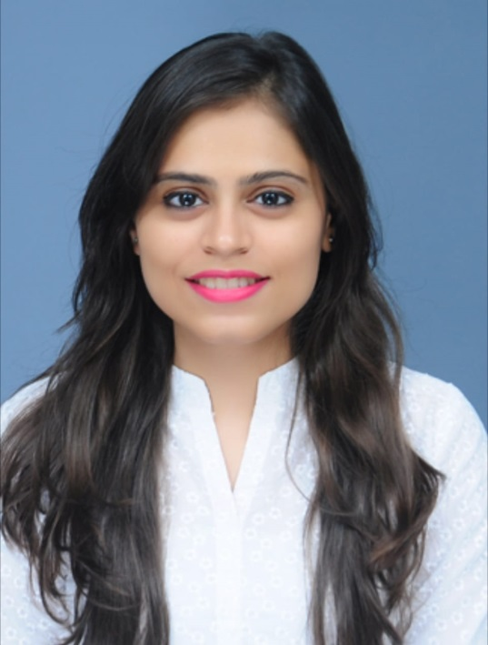
For Your Reference
Accountant and IT Head
Mr. Dharmendra Sakure
Transport In-charge
Mr. Suresh Gautam
Relationship Manager
Ms. Manisha Keswani

Slide 13
School Timings
Grade: Nursery to Sr. Kg ( Monday to Saturday)
Time : 8:50 a.m. – 1:00 p.m.
Time to meet Educators :- 01:30 p.m. to 02:30 p.m.
Principal Meeting Time :- 11:00 a.m. to 01:00 p.m (Monday to Friday)
Office Timings :- 09:00 a.m. to 05:00 p.m. (Monday to Saturday)

Slide 14
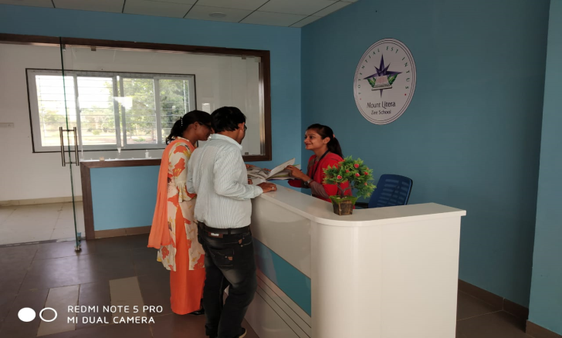
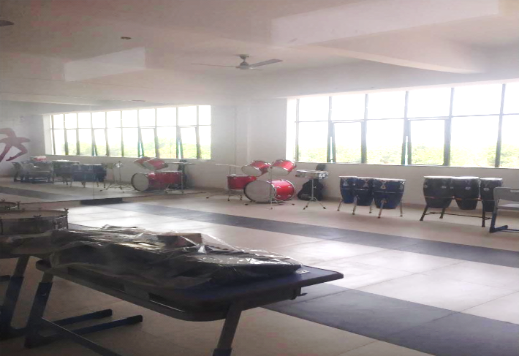
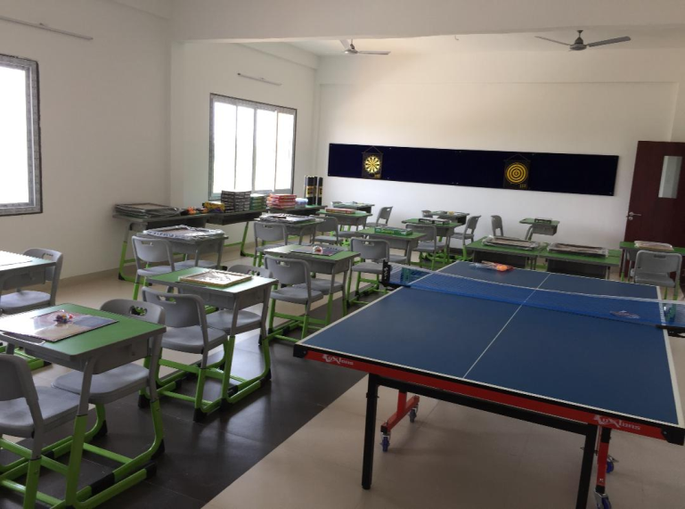
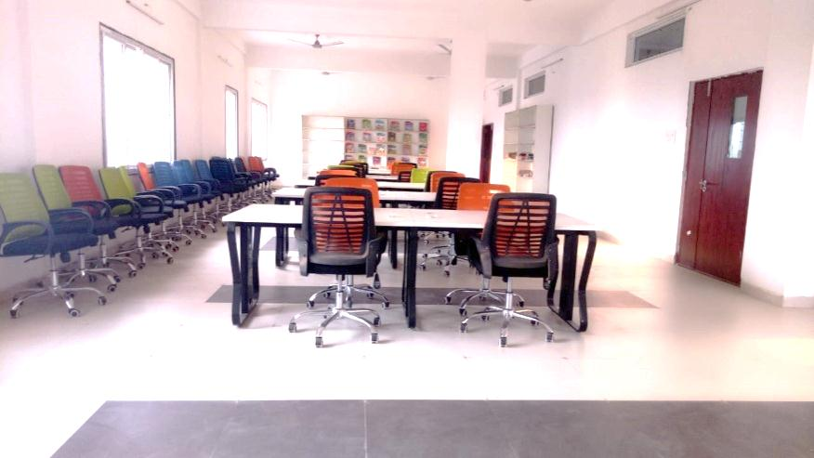
Our Infrastructure
Reception
Music Room
Indoor Play Area
Our Library

Slide 15
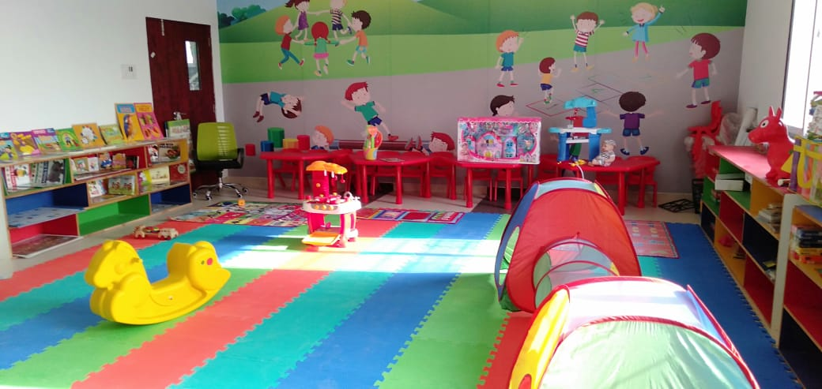
Our Infrastructure
ILLUME ROOM

Slide 16
Guidelines For Parents
Please check the diary(Almanac) regularly ( Pg 2,4,5,6,7)
Kindly go through the circulars and remove them and keep them safe with you.
Communication should be done only through the Almanac.
Almanac should be brought to school daily.
Make sure your child wears the ID card everyday.
Please refer the Almanac for all the activities and the requirement
mentioned for the activities scheduled for the particular month.
Uniform should be neat and clean as well as ironed.
Follow the school timing strictly.
For any queries contact at reception and kindly specify your ward’s
name and class and the name of the person you wish to talk to.

Slide 17
Guidelines For Parents
Encourage your ward to participate in all the activities conducted.
Curtail the absenteeism, as it hampers the child’s learning process.
No fancy or costly accessories allowed.
4 photographs to be sent in school dress.
Please submit the stationery, notebooks and textbooks to the
respective teachers.
Parents are requested to ask what is done in the class, child
intentionally might ignore, encourage them to tell on their own.

Slide 18
Uniform
Boys
Parrot Green Tee Shirt and Navy Blue Shorts.
Black shoes, Navy blue socks, Belt

Slide 19
Uniform
Girls
Parrot Green Tee Shirt and Navy Blue Skirt.
Black shoes, Navy blue socks, Belt

Slide 20
Birthday Policy
Students are required to bring any small
chocolate of value Rs. 1 or Rs. 2.
Parents are requested not to give any gift or
token of gratitude to the educators.
No birthday parties will be held in school.
No birthday gifts or return gifts will be
exchanged with students.
Private birthday invitations should be mailed rather
than passed in class, unless the whole class is invited.
Send your child in decent party dress along with I-card.

Slide 21
Health And Hygiene
In some cases, if the medical attention is required
specially please keep the Principal of the school
informed in written at all times with doctor’s prescription attached.
No student should attend school if he/she is suffering
with serious or contagious disease. They will be allowed to attend the school again when a medical certificate is produced.
Please fill the details in the Health form. The Health
form should be filled by your Family doctor or any
Paediatrician only.

Slide 22
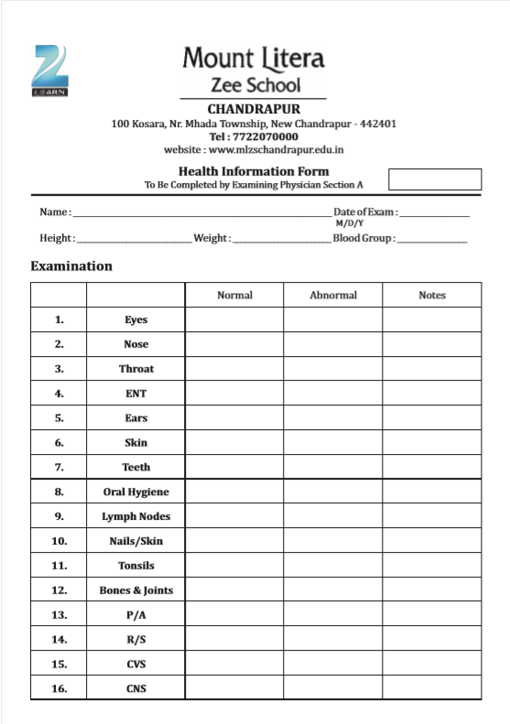
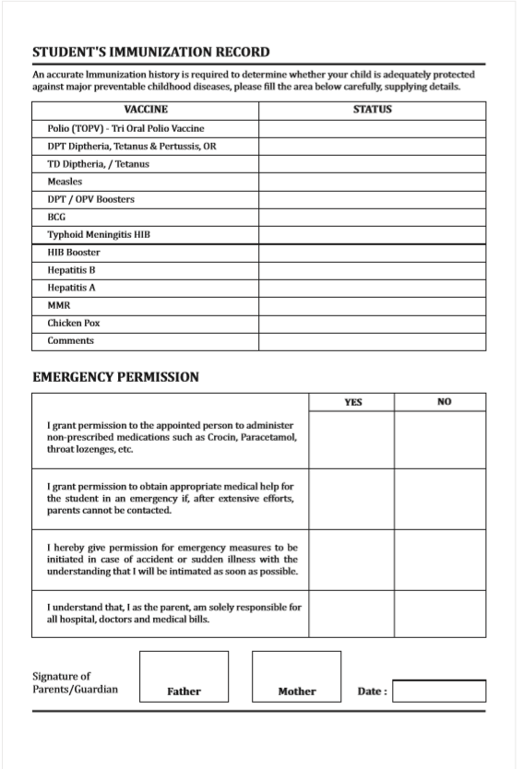

Slide 23
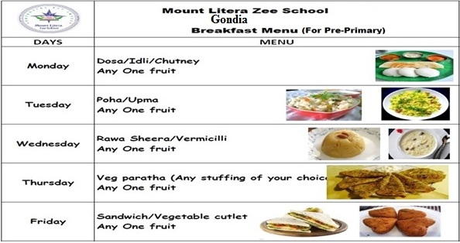
Suggested Menu Card
** No junk food and packed food are allowed
If your child is allergic to certain food, kindly avoid it in his / her Tiffin box
Send napkins, spoons and forks every day with your child
Note : This is Suggested Menu. If your child is allergic to any particular food kindly don’t send it.

Slide 24
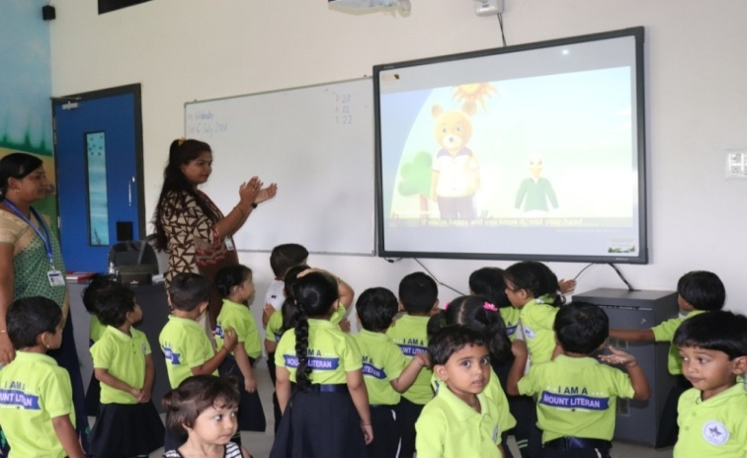
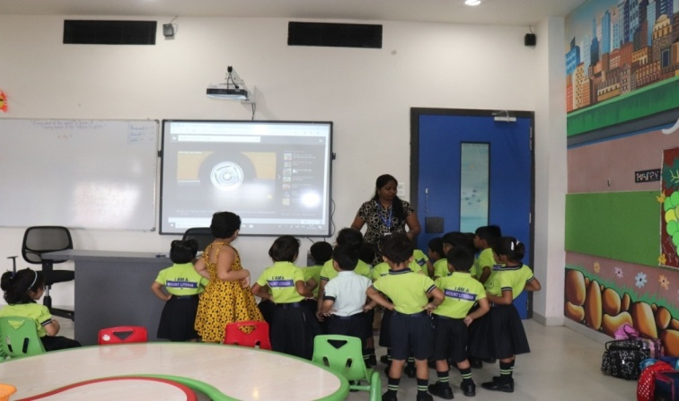
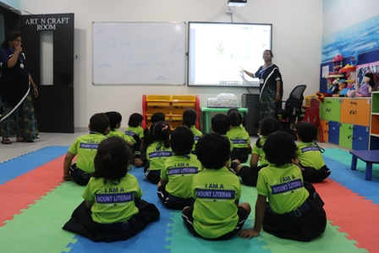
Smart Class

Slide 25
Mother Educator Concept for Pre-Primary
Subjects that will be taught by mother educator :
English
Mathematics
Hindi
General Awareness ( G. A.)
EVS
Field Trips

Slide 26
Educators For Pre-Primary
Ms. Firdosh Ansari- Senior KG
Ms. Vedanti Patle- Junior KG
Ms. Priyanka Katre- Nursery

Slide 27
Term Details
Nursery to Sr. Kg has 3 terms
Term | FROM | TO
I | 18-06-2019 | 30-09-2019
II | 01-10-2019 | 25-01-2020
III | 28-01-2020 | 15-04-2020

Slide 28
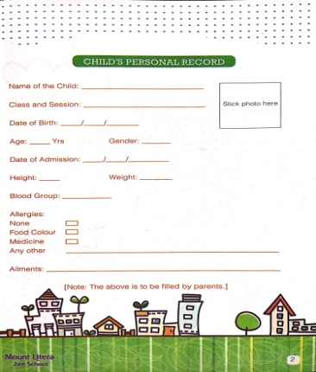
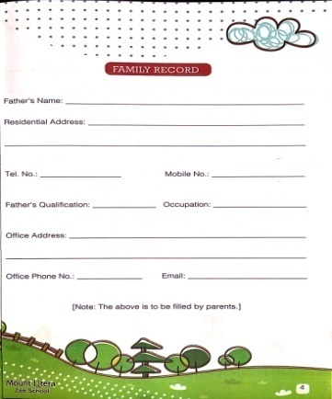
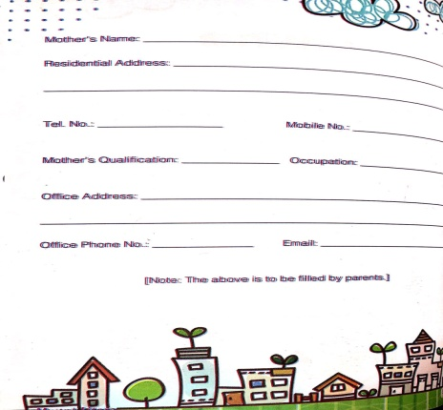
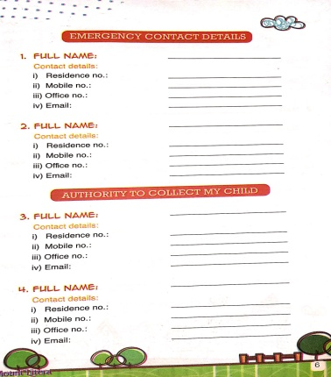
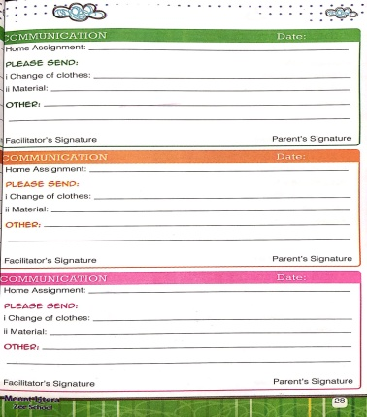
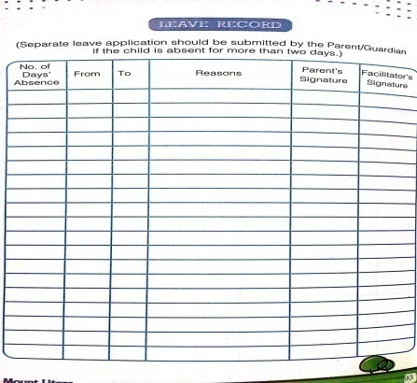
Almanac

Slide 29
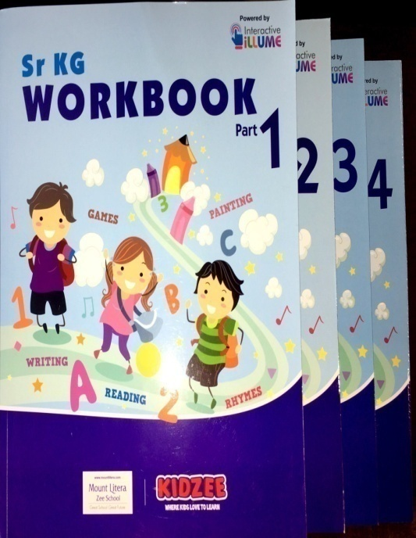
Workbooks

Slide 30
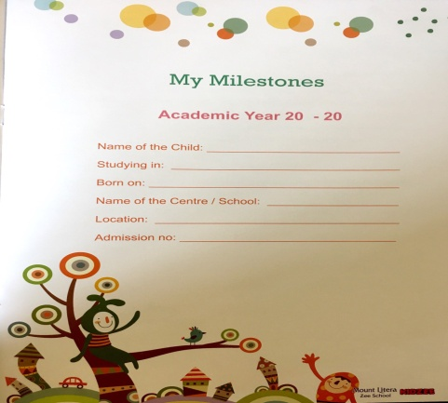
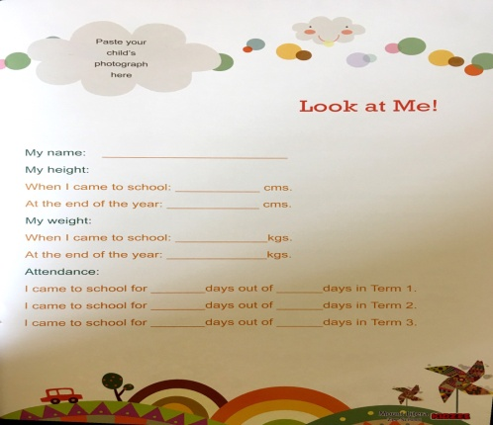
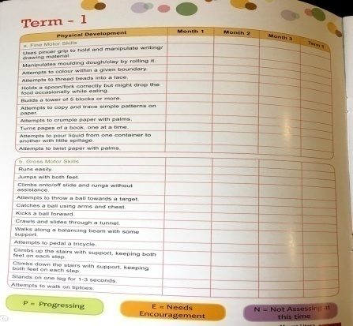
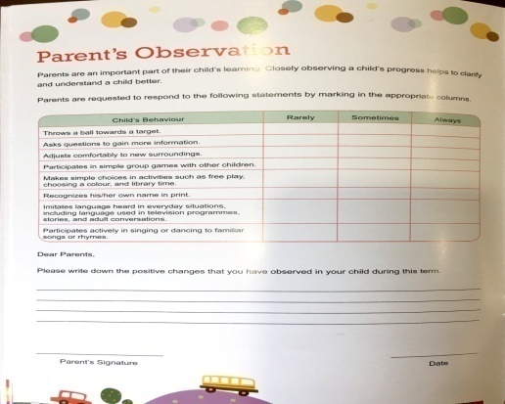
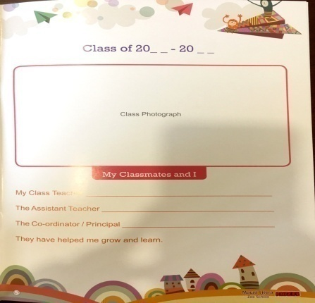
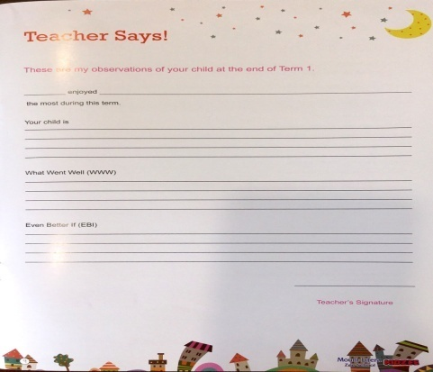
Milestone

Slide 31
Daily Time-Table of Nursery
Periods | Monday | Tuesday | Wednesday | Thursday | Friday | Saturday
Period 1 9:25 - 9:50 | Concept Time | Concept Time | Concept Time | Concept Time | Concept Time | Concept Time
Period 2 9:50 - 10:15 | Math Time | Math Time | Math Time | Math Time | Math Time | Math Time
Period 3 10:15 - 10:35 | Music Time | Music Time | Music Time | Music Time | Music Time | Music Time
Break1 10:35 - 11:00
Period 4 11:00 - 11:20 | Free Play Time | Free Play Time | Free Play Time | Free Play Time | Free Play Time | Free Play Time
Period 5 11:20 - 11:45 | Language Time | Language Time | Language Time | Language Time | Language Time | Language Time
Break2 11:45 - 11:50
Period 6 11:50 - 12:10 | Skill Based Learning 1 | Skill Based Learning 1 | Skill Based Learning 1 | Skill Based Learning 1 | Skill Based Learning 1 | Skill Based Learning 1
Period 7 12:10 - 12:30 | Skill Based Learning 2 | Skill Based Learning 2 | Skill Based Learning 2 | Skill Based Learning 2 | Skill Based Learning 2 | Skill Based Learning 2
Period 8 12:30 - 12:55 | Exploration Time | Exploration Time | Exploration Time | Exploration Time | Exploration Time | Exploration Time

Slide 32
Daily Time-Table of Junior KG
Periods | Monday | Tuesday | Wednesday | Thursday | Friday | Saturday
Period 1 9:25 - 9:50 | Concept Time | Concept Time | Concept Time | Concept Time | Concept Time | Concept Time
Period 2 9:50 - 10:15 | Math Time | Math Time | Math Time | Math Time | Math Time | Math Time
Period 3 10:15 - 10:35 | Music Time | Music Time | Music Time | Music Time | Music Time | Music Time
Break1 10:35 - 11:00
Period 4 11:00 - 11:20 | Free Play Time | Free Play Time | Free Play Time | Free Play Time | Free Play Time | Free Play Time
Period 5 11:20 - 11:45 | Language Time | Language Time | Language Time | Language Time | Language Time | Language Time
Break2 11:45 - 11:50
Period 6 11:50 - 12:10 | Skill Based Learning 1 | Skill Based Learning 1 | Skill Based Learning 1 | Skill Based Learning 1 | Skill Based Learning 1 | Skill Based Learning 1
Period 7 12:10 - 12:30 | Skill Based Learning 2 | Skill Based Learning 2 | Skill Based Learning 2 | Skill Based Learning 2 | Skill Based Learning 2 | Skill Based Learning 2
Period 8 12:30 - 12:55 | Exploration Time | Exploration Time | Exploration Time | Exploration Time | Exploration Time | Exploration Time

Slide 33
Daily Time-Table of Senior KG
Periods | Monday | Tuesday | Wednesday | Thursday | Friday | Saturday
Period 1 9:25 - 9:50 | Concept Time | Concept Time | Concept Time | Concept Time | Concept Time | Concept Time
Period 2 9:50 - 10:15 | Math Time | Math Time | Math Time | Math Time | Math Time | Math Time
Period 3 10:15 - 10:35 | Skill Based Learning 1 | Skill Based Learning 1 | Skill Based Learning 1 | Skill Based Learning 1 | Skill Based Learning 1 | Skill Based Learning 1
Break1 10:35 - 11:00
Period 4 11:00 - 11:20 | Language Time | Language Time | Language Time | Language Time | Language Time | Language Time
Period 5 11:20 - 11:45 | Skill Based Learning 2 | Skill Based Learning 2 | Skill Based Learning 2 | Skill Based Learning 2 | Skill Based Learning 2 | Skill Based Learning 2
Break2 11:45 - 11:50
Period 6 11:50 - 12:10 | Free Play Time | Free Play Time | Free Play Time | Free Play Time | Free Play Time | Free Play Time
Period 7 12:10 - 12:30 | Music Time | Music Time | Music Time | Music Time | Music Time | Music Time
Period 8 12:30 - 12:55 | Exploration Time | Exploration Time | Exploration Time | Exploration Time | Exploration Time | Exploration Time

Slide 34
Homework Policy
Grade- Nursery & Jr. Kg
Every Tuesday and Friday.
Grade- Sr. Kg
Everyday
Applicable from month August. We are going to send Homework through E+ as well.

Slide 35
Stationery Details
Grade – Nursery & Jr. Kg
Grade – Sr. Kg
Row Labels | Quantity
Pencils (Pkt) Apsara | 2
Eraser (1 Pkt = 10 rubbers) | 1
Sharpner | 2
Crayon Set | 1
Row Labels | Quantity
Pencils (Pkt) Apsara | 2
Eraser (1 Pkt = 10 rubbers) | 1
Sharpner | 2
Crayon Set | 1

Slide 36
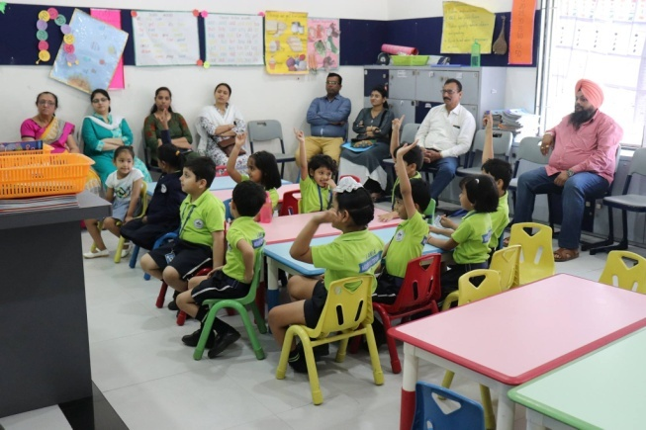
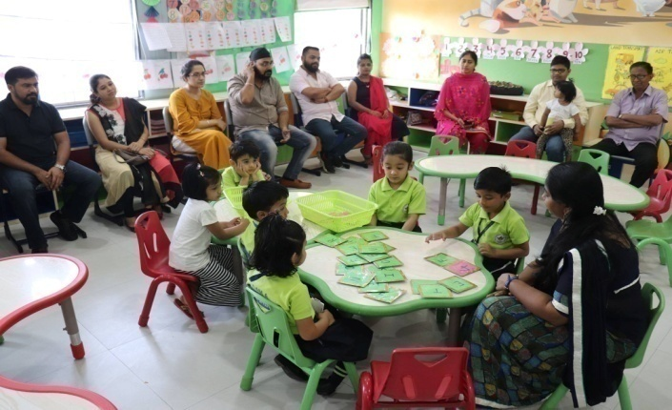
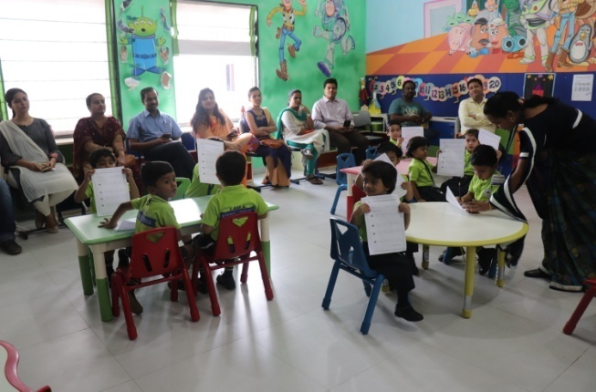
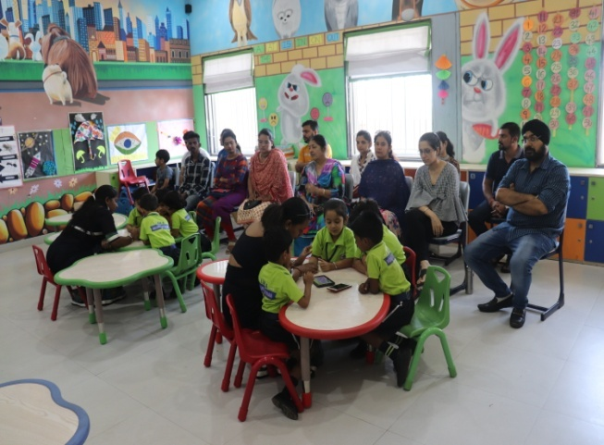
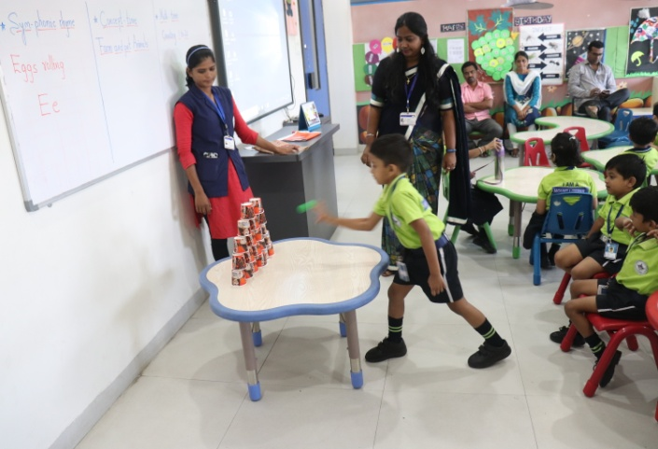
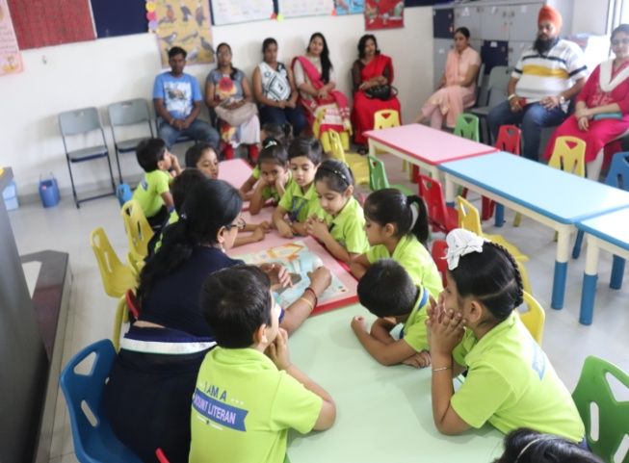
Subject Enrichment Culmination Activity

Slide 37
Luminosity
MEET LUMINOSITY, THE NEW AGE LEARNING MANAGEMENT SYSTEM (LMS)
https://drive.google.com/open?id=1hKz3eDFXMKCWi2hEUtsGNp6QznTmwvz3

Slide 38
Code Of Conduct For Parents
Show respect and support for your child, the educators, and
the school.
Do not talk ill about any educator or school authority in
front of the students.
Have positive attitude towards the school and cooperate with
the teachers towards the betterment of the student.
Develop reading habit in your child by example.
Support the school’s discipline policy.
Encourage the child to be regular and punctual in attending
the school.
No half day is allowed to any child unless there is an emergency.

Slide 39
Parent on campus
We strongly believe that Holistic Development of students is based on 4 pillars : Student, Parent, Teacher and School.
To further strengthen the bond of all stakeholders, we hereby introduce the “Parent on Campus” policy.
In short, everyday one parent can come and be present in the school campus before the start of the school till the end of the school.
This will not only enhance the trust between parents and school but will prove to an important step towards fostering a relationship of confidence.
This is an effort to supplement and re-enforce our commitment to provide Safe and Secure Environment and to make parents as Partners in our endeavor of imparting Holistic Quality Education. Looking forward to working together and successful Cooperation.

Slide 40
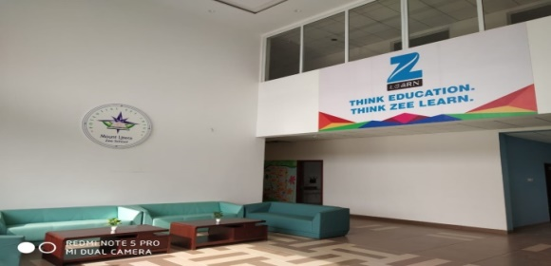
Parent’s complaint disposal system
Parents to contact the Complaint Handling Coordinator i.e. Principal for any complaints regarding transport and academics.
The complaint can be in the mode of e-mail and in written mode between 10.00 a.m. to 1.00 p.m. (Monday to Saturday only)
Ph. No. 06262626969, email id : principal.gondia@mountlitera.com
The CHC will maintain the record of the complaints made and convey it to the concerned authority on the same day.
The CHC will be responsible for taking the feedback and the proper closure from the concerned authority and will give a proper closure to the parent within 3 days of lodging the complaint.
The parents will contact the Academic Co-ordinator for any complaints regarding the academics ( by written mode or through emails only).
Mount Litera Zee School,Gondia

Slide 41
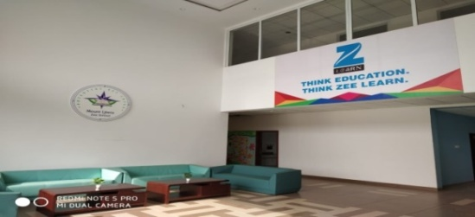
Feedback Hierarchy
For any queries, suggestions, feedbacks and complaints kindly follow the hierarchy:
Academics related
Class teacher (3 Days)
Principal (3 Days)
Regional School Director
Sources of Feedback
Emails to Coordinators or Principal
Feedback to Front Office (FO)
Feedback during PTA meetings
Feedback to Hon. Chairman Sir
Mount Litera Zee School, Gondia

Slide 42
CHC
Parent’s Complaint Disposal System
Principal (3 Days)
Admin Related
Regional School Director
Mount Litera Zee School, Gondia

Slide 43
Escort Card
Guidelines:
Escort Card should be issued to every child every year.
Kindly stick the necessary photographs of the parent/guardian in a manner that the child would be handed over to the people whose photos have been stuck on the card.
Please report to the admin office/class teacher if card will be lost. Same card has to be issued with a DUPLICATE STAMP on it with some charges.
Children (including Bus ) will be handed over to the concerned person by checking the escort card only.
Mount Litera Zee School, Gondia

Slide 44
E-Plus
Education Plus
Education Plus is very user friendly and cost effective school software
That comes with a set of user-friendly dashboards with separate login access to Administrator, Teachers, Students, Principal, Parents, Accountant, Librarian and Management body of the Institution.
It is easy way of communication between parents and teachers.
Mount Litera Zee School, Gondia

Slide 45
Our Philosophy
Every aspect, action and decision at Mount Litera Zee School is governed by a single, simple principle –
“What’s Right For the Child (WRFC)”. This helps us keep the child at the centre of the everything we do and ensures single-minded devotion to their growth and development.

Slide 46
Know more about us
School Website:
www.mlzsgondia.com
• Facebook Page: Mount Litera Zee School Gondia

Slide 47
THANK YOU

